Slide 1
Ergonomics

Slide 2
What is Ergonomics?
ERGO= “work”
NOMICS=
“laws”
Ergonomics literally means “the laws of work”

Slide 3
What is Ergonomics?
“designing the job to fit the worker, instead of forcing the worker to fit the job.”

Slide 4
What is Ergonomics?
Ideally, ergonomics
  Makes the job safer by preventing injury and illness
  Makes the job easier by adjusting the job to the worker
  Makes the job more pleasant by reducing physical and mental stress
  Saves money

Slide 5
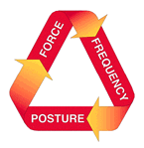
Analyzing Workplace Hazards
Fixed or awkward work postures for more than a total of 2 hrs, such as bending, bent wrist, kneeling, twisting, or squatting.
Use of vibration or impact tools.
Lifting more than 35kgs once during the work shift or 20kgs more than 10 times /day.
Lifting more than 25lbs above shoulders, below knees or at length more than 25 times per day.
Workers complaints of physical aches and pains related to their work assignments.

Slide 6
Back Injuries
Back injuries are some of the most common and costly injuries in the work place
An estimated 80% of Americans will suffer a back injury at some time in their life
Low back pain most commonly occurs in people aged 30 to 50 years old
Back injuries cause loss of work and cost billions of dollars per year

Slide 7
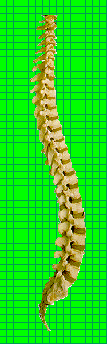
Lower back in arched position
Keep the lower back in its normal, “arched” position while lifting (With back arched, forces are more evenly distributed on the support structures)

Slide 8
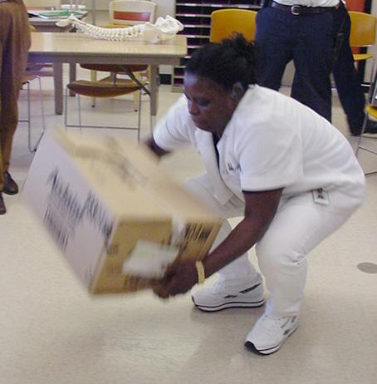
Awkward Loads
It is better to drop a heavy or awkward load rather than risk an injury by jerking or moving incorrectly

Slide 9
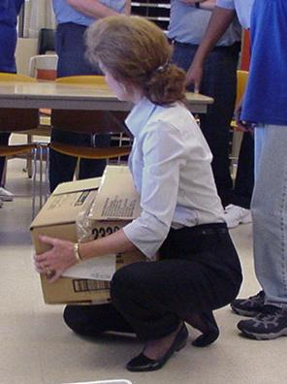
Lifting
Bring the load as close to the body as possible and no more than waist high. (The closer to your spine, the less force it exerts on your back.)

Slide 10
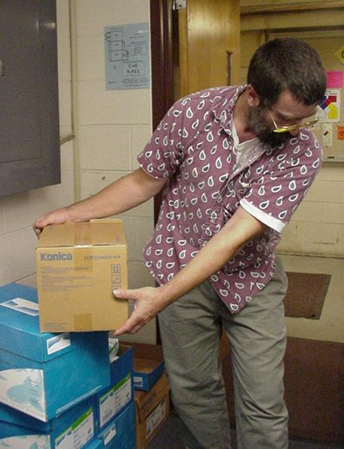
Steps to Prevent Back Injuries
Avoid twisting motion as you move objects
Notes:
If you need to change direction, pivot rather than twist. Lifting improperly and then twisting triples your risk of a back injury.

Slide 11
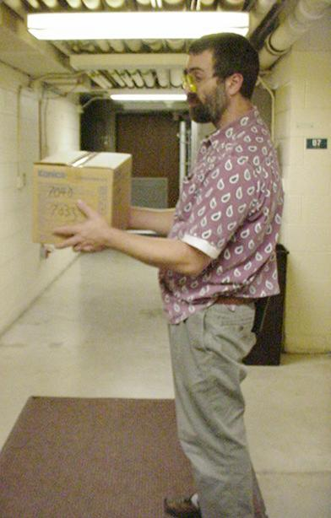
What’s Wrong in This Picture?
A 10 pound box held close to the body exerts 10 pounds of pressure on the lower back. That same 10 pound box held out from the body exerts 100 pounds of pressure on the lower back

Slide 12
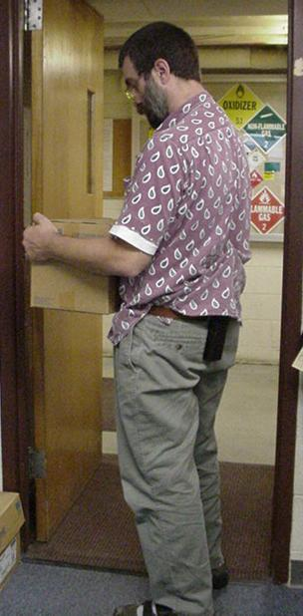
Lifting
Tuck your arms and elbows into your side and your chin into your neck.

Slide 13
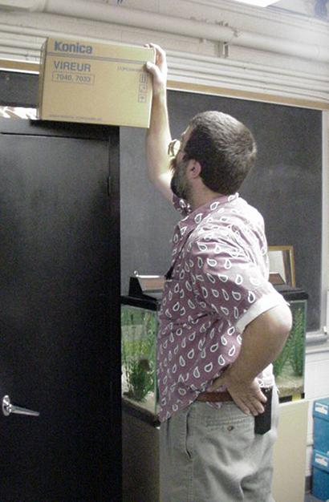
Steps to Prevent Back Injuries
Do not reach for things above your head or out of reach
Heavy items should be kept between 30-50” from floor to eliminate need for reaching

Slide 14
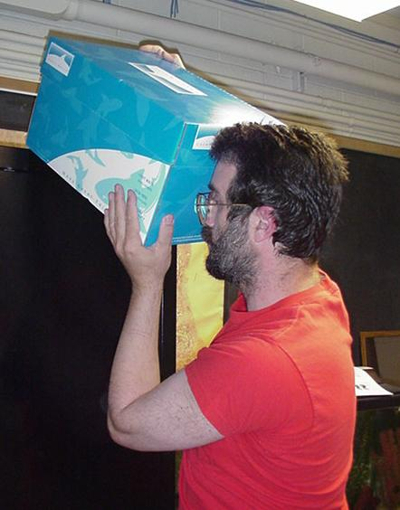
Lowering from a High Place
Lighten load, if possible
Stand on something sturdy with one foot in front of the other
Get help if load is awkward or heavy

Slide 15
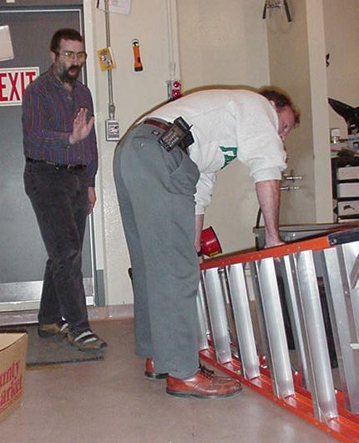
What’s Wrong in This Picture?
Ladder is too heavy and awkward to carry alone – request assistance from co-worker

Slide 16
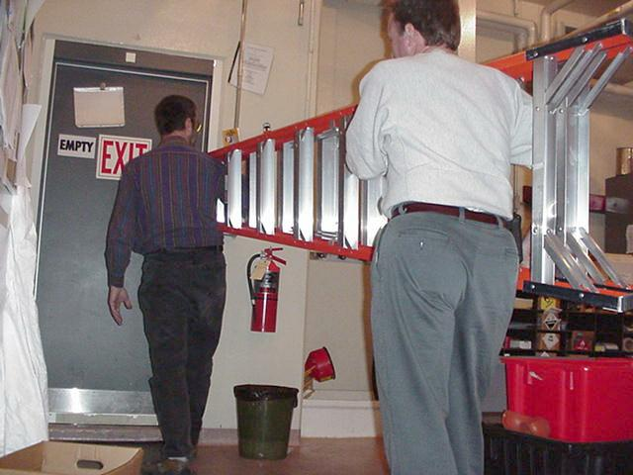
Ask for Help
If an item is too heavy or awkward to carry, request assistance from a co-worker

Slide 17
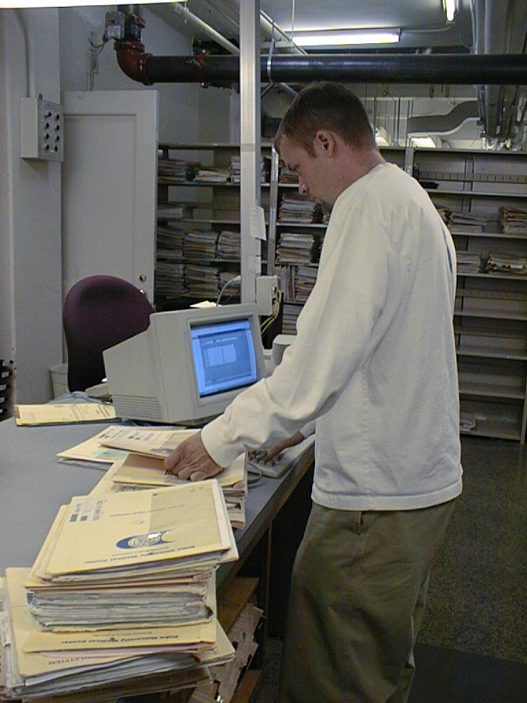
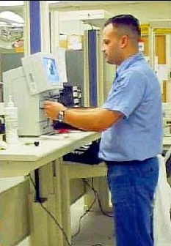
Awkward Postures
Awkward or unsupported postures that stretch physical limits, can compress nerves and irritate tendons
Before: Lab technician tilts his neck forward to view the screen into a non-neutral posture. He also bends over resting on his forearms to write on the documents.
Ergonomic Improvement: Sailor easily views the screen from a neutral posture. The workstation adjusts to accommodate different working heights and users. When standing, work should be about elbow height.

Slide 18
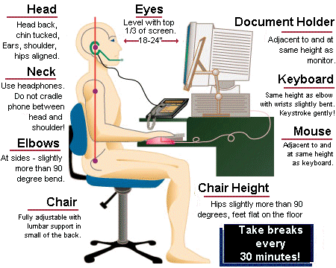
Office Ergonomics

Slide 19
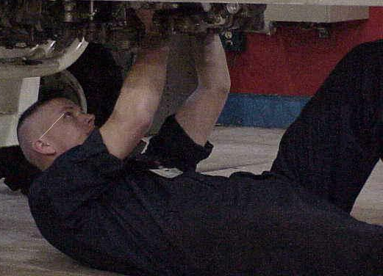
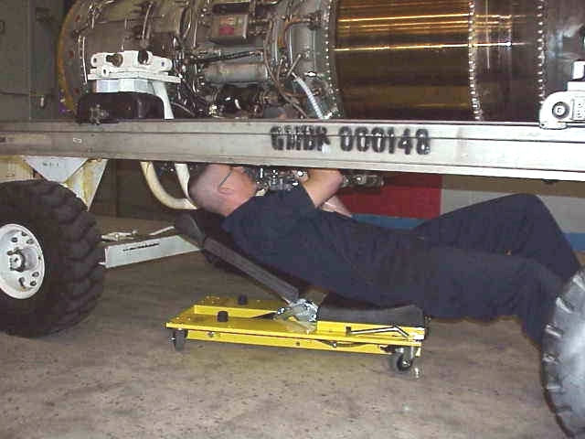
Static Postures
Holding the same position or using the same muscles for extended periods of time
Static postures, or positions that a worker must hold for long periods of time, can restrict blood flow and damage muscles
Before: Mechanic maintains a static posture holding arms and hands elevated while repairing aircraft
Ergonomic Improvement: Creeper supports mechanic and brings him closer to the task

Slide 20
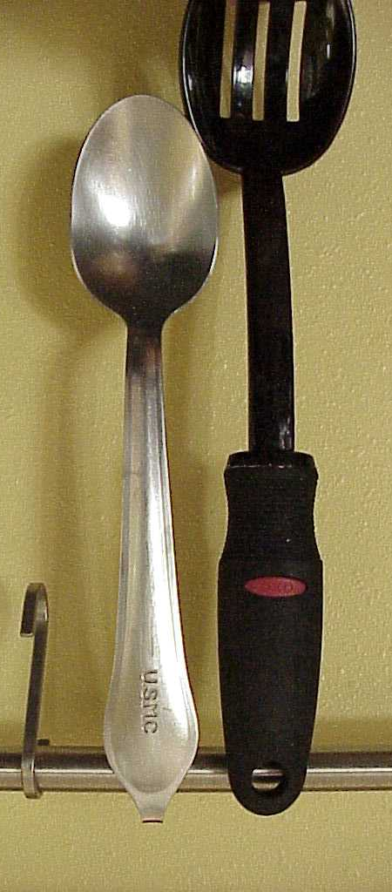
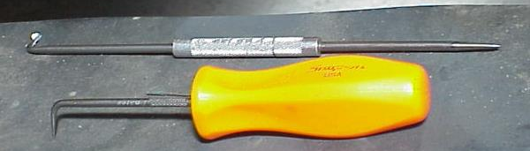
Compression
Soft tissue is compressed between the bone and a hard or sharp object
Compression, from grasping or contacting edges like tool handles, can concentrate force on small areas of the body, reduce blood flow and nerve transmission and damage tendons and tendon sheaths
Before: Tool handles are small and angular requiring the worker to grasp tightly against sharp edges
Ergonomic Improvement: Tool handle is formed to fit the worker’s hand which requires less grip strength or force and a more user-friendly tool

Slide 21
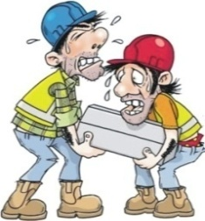
Bending Down
WASTES
Productive Time !!!
Slim Lift for Ergonomics - FERRO TIGER
Ferro Foundries Pvt. Ltd. Hunsur Road, Belwadi P.O. Mysore 570018 INDIA. | Tel: +91 821 4254600 | Mob: +91 9945820878 | Email: info@ferrotiger.com

Slide 22
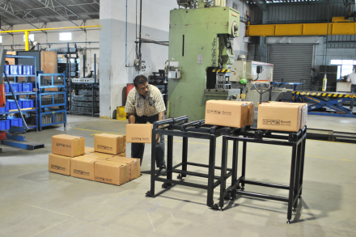
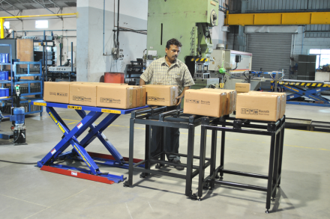
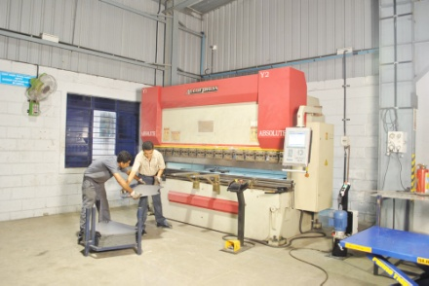
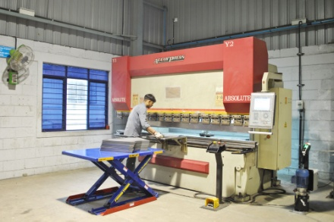
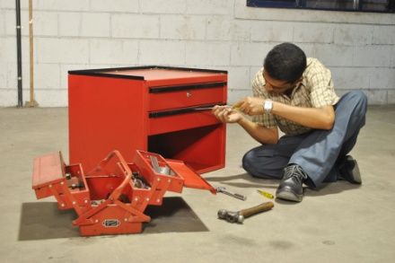
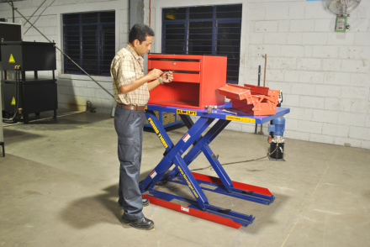
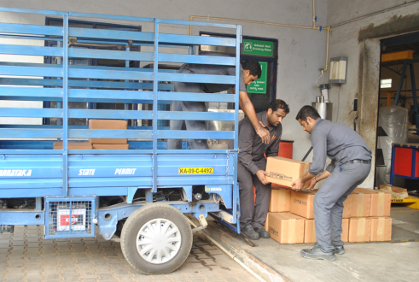
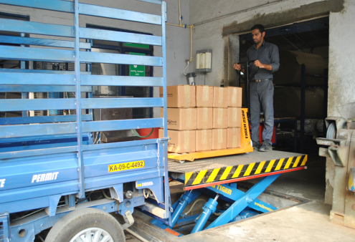
Slim Lift for Ergonomics - FERRO TIGER
Before
After
Ferro Foundries Pvt. Ltd. Hunsur Road, Belwadi P.O. Mysore 570018 INDIA. | Tel: +91 821 4254600 | Mob: +91 9945820878 | Email: info@ferrotiger.com

Slide 23
Scissor Lifts for Ergonomics FERRO TIGER
Before
After
Ferro Foundries Pvt. Ltd. Hunsur Road, Belwadi P.O. Mysore 570018 INDIA. | Tel: +91 821 4254600 | Mob: +91 9945820878 | Email: info@ferrotiger.com

Slide 24
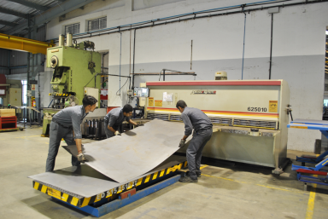
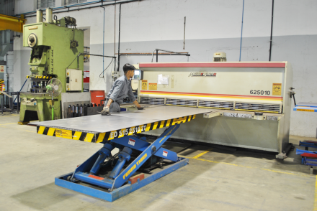
Scissor Lifts for Ergonomics FERRO TIGER
Before
After
Ferro Foundries Pvt. Ltd. Hunsur Road, Belwadi P.O. Mysore 570018 INDIA. | Tel: +91 821 4254600 | Mob: +91 9945820878 | Email: info@ferrotiger.com

Slide 25


Elevating Docks - FERRO TIGER
Before
After
Ferro Foundries Pvt. Ltd. Hunsur Road, Belwadi P.O. Mysore 570018 INDIA. | Tel: +91 821 4254600 | Mob: +91 9945820878 | Email: info@ferrotiger.com

Slide 26
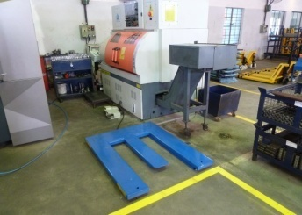
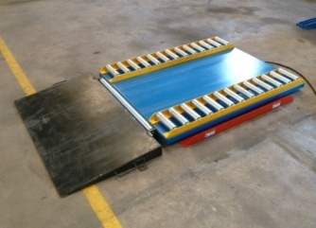
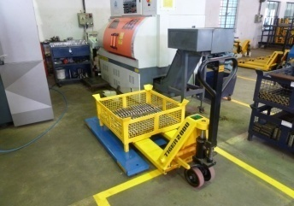
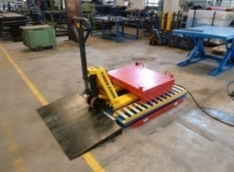
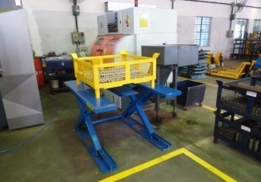
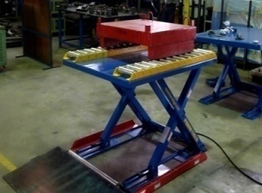
Slim Lift Application
1
1
2
2
3
3
Ferro Foundries Pvt. Ltd. Hunsur Road, Belwadi P.O. Mysore 570018 INDIA. | Tel: +91 821 4254600 | Mob: +91 9945820878 | Email: info@ferrotiger.com

Slide 27
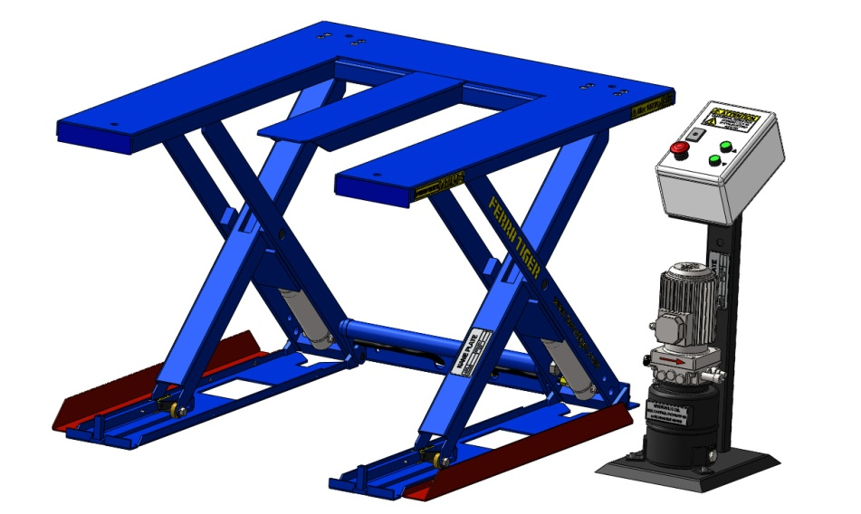
SLIM LIFT
Bending Down
WASTES
Productive Time !!!
SLIM LIFT is perfect answer to handle heavy loads at working heights and can also be used as a work positioner. It is easy to install and it can be placed directly on the floor NO PIT REQUIRED. If a pit is required, it can be made so shallow – only 90mm deep – thus leaving structural elements intact. SLIM LIFT is the perfect solution for efficient lifting, lowering and positioning on intermediate, suspended or mezzanine floors, they take the backache and strain out of bending & lifting.
Features
NO PIT REQUIRED
Lifting capacity up to 2000 kg
Closed table height of 90mm
Maximum table height of 900mm
Power Pack – Bosch Rexroth
Application
Machine feeding
Conveyor feeding
Ergonomic work station
Pallet positioner
Parts Assembly & Servicing
Safety
Hose burst valve
Over load protection
Toe guards
Mechanical maintenance locks
Low Control Voltage - 24V DC
Model Code | Capacity (kg) | Table Size (l x b) (mm) | Max Ht (mm) | Min Ht (mm) | Stroke (mm) | Raise/Lower time (sec) | Motor (HP)
LH 90A 1T | 1000 | 1350 x 600 | 900 | 90 | 810 | 15 | 1.5
LH 90B 1T | 1000 | 1350 x 800 | 900 | 90 | 810 | 15 | 1.5
LH 90C 1T | 1000 | 1350 x 1050 | 900 | 90 | 810 | 15 | 1.5
LH 100A 2T | 2000 | 1400 x 800 | 900 | 100 | 800 | 20 | 1.5
LH 100B 2T | 2000 | 1400 x 1000 | 900 | 100 | 800 | 20 | 1.5
LH 100C 2T | 2000 | 1400 x 1200 | 900 | 100 | 800 | 20 | 1.5
Specifications subject to change | Conveyor Roller & Ramp available as optional accessory | Tailor made table configurations
Slim Lift – Table Configuration
Rectangular Table
C - Table
E - Table
l
600mm
b
E - Table
Declaration of Conformity
E - Table
EN 1570
Manufactured in accordance
with the requirements of the
lift table standards
EN1570
Tel: +91 821 4254600 | Mob: +91 9945820878 | E-Mail: info@ferrotiger.com | Web: www.ferrotiger.com
Office & Factory Address: Ferro Foundries Pvt. Ltd., Belwadi P.O., Mercara Road, Mysore 570018, INDIA.

Slide 28
Reach Us At
Info@ferrotiger.com
Tel: +91 821 4254600
Mob: +91 9945820878
Ferro Foundries Pvt.Ltd.
Hunsur Road Belwadi P.O.
Mysore 570018
INDIA.

